Slide 1
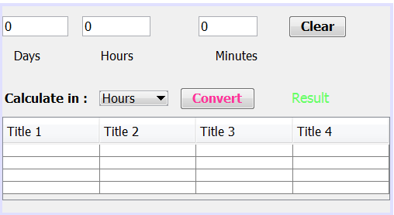
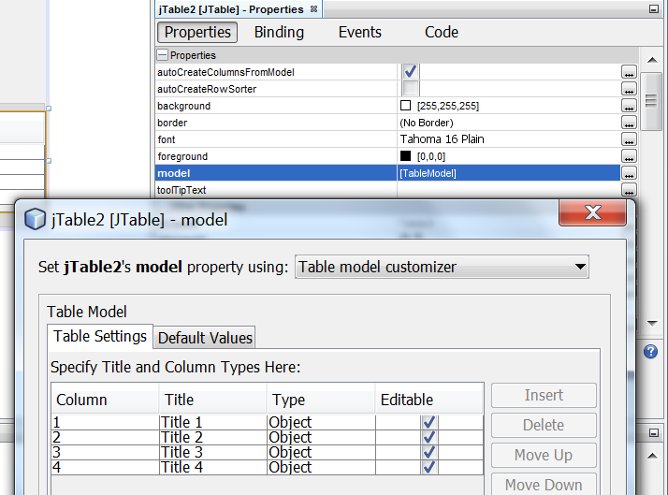
Show output in a Table
Now, we would like to organize the inputs and results a table.
We can use a Jtable component.
Add a Scroll pane to your GUI.
Add a Table to the Scroll pane.
To change your table settings>>click on the table>> model row in the Properties>> Table Settings>>Insert, Delete, edit Titles.
Row 0
Row 1
Col 0
Col 1

Slide 2
Show output in a Table
You can set the column header within your code using the following:
table.getColumnModel().getColumn(0).setHeaderValue(“Hours");
This should be done as soon as opening your form for the first time, which means in the constructor.

Slide 3
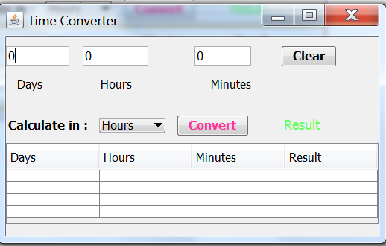
Show output in a Table
Set the Column headers as shown.
Add the code in the Convert button to show the inputs and results in the table.
To set a value in the table, you use
setValueAt(value, row, column) method>>
TableVariableName.setValueAt( ).
Note that the first row and column index is 0.

Slide 4
Show output in a Table
Modify the Convert Button action performed:
Define a string variable>>String resultVal
Change the if else statements:
For hours: resultVal=d*24+h+m/60+ “hours”;
For minutes: resultVal=d*24*60+h*60+m+ “mins”;
For seconds: resultVal=d*24*60*60+h*60*60+m*60+ “sec”;
You can now delete the result label from your design.
Set the table values.

Slide 5
Show output in a Table
Not here
int row=0;// start from the first row index
//Test which time is selected
if(item.equals("Hours")){ resultVal=d*24+h+m/60+"hours"; }
else if(item.equals("Minutes")){ resultVal=d*24*60+h*60+m+"mins"; }
else{ resultVal=d*24*60*60+h*60*60+m*60+"sec"; }
//set the values
table.setValueAt(d, row, 0);
table.setValueAt(h, row, 1);
table.setValueAt(m, row, 2);
table.setValueAt(resultVal, row, 3);
row++;// Go to next row

Slide 6
Show output in a Table
Test your Application.
Is their any problem?
Why every operation is written in the same row (first row)?
How can we solve this problem?

Slide 7
Show output in a Table
Define int row as an integer property for the TimeConverter Frame.
Set the initial value >>row=0; in the constructor
public class timeform extends javax.swing.JFrame {
int row;
public timeform() {
initComponents();
table.getColumnModel().getColumn(0).setHeaderValue("Days");
row=0;
}

Slide 8
Open a new form from a button
Create a new form for showing the results called showresults for example.
In the actionPerformed of a new button on your initial form, you can add the code:
This will create an instant from the class object with the name anyname and will make it visible on button click.
showresults anyname= new showresults();
anyname.setVisible(true);

Slide 9
Write results in an array list
Class constructor
public class timeform extends javax.swing.JFrame {
private int row;
protected static ArrayList<String> results;
public timeform() {
initComponents();
table.getColumnModel().getColumn(0).setHeaderValue("Days");
row=0;
results = new ArrayList<>(); }
Set results in the array list
if(combo.getSelectedItem()=="in hours") {
result= D*24+H+M/60;
results.add(Double.toString(result)+" Hours"); }
else if(combo.getSelectedItem()=="in minutes"){
result= D*24*60+H*60+M;
results.add(Double.toString(result)+" minutes"); }
else if(combo.getSelectedItem()=="in seconds"){
result= D*24*3600+H*3600+M*60;
results.add(Double.toString(result)+" seconds"); }

Slide 10
Open a new form from a button
Now you can show the results in the new form using the array list from your initial form (timeform)
This should be done as soon as opening the new showresults form ➔ in the constructor of the new form.
public showresults() {
initComponents();
for (int i=0; i<timeform.results.size(); i++){
table.setValueAt(timeform.results.get(i), i, 0); }

Slide 11
Assignment1: Temperature Converter

Slide 12
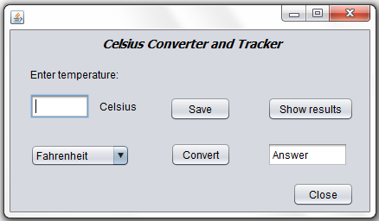
Assignment1: Temperature Converter
The main idea of this assignment is to create a temperature converter from Celsius to Fahrenheit or to Kelvin.
The entered values will be saved into a file.
They will be then read from the file, and shown in a dynamically created table inside a dynamically created form
We need to create the following form:

Slide 13

The action for Convert button
To convert from Celsius to Fahrenheit, we need to apply the following conversion equation:
Temperature in Fahrenheit = (Temperature in Celsius)*1.8 + 32
To convert from Celsius to Kelvin, we need a different equation:
Temperature in Kelvin = (Temperature in Celsius) + 273.15
//Parse degrees Celsius as a double and convert to Fahrenheit.
int tempFahr = (int)((Double.parseDouble(tempTextField.getText())) * 1.8 + 32);
fahrenheitLabel.setText(tempFahr + " Fahrenheit");
//Parse degrees Celsius as a double and convert to Kelvin
int tempkel = (int)(Double.parseDouble(tempTextField.getText())+ 273.15);
kelvinLabel.setText(tempkel + " Kelvin");

Slide 14
The action for Save button
To convert from Celsius to Fahrenheit, we need to apply the following conversion equation:
Temperature in Fahrenheit = (Temperature in Celsius)*1.8 + 32
To convert from Celsius to Kelvin, we need a different equation:
Temperature in Kelvin = (Temperature in Celsius) + 273.15
FileWriter out;
try {
out = new FileWriter("Temp.txt", true);
out.write(output.getText()+"\n");
out.close();
} catch(IOException e) {
System.out.println("Error appending to file " + "Temp.txt");
}

Slide 15
The action of Show results button
ArrayList<String> myArr = new ArrayList<>();
int rows;
try {
FileInputStream fStream = new FileInputStream("Temp.txt");
BufferedReader in = new BufferedReader(new InputStreamReader(fStream));
while (in.ready()) {
myArr.add(in.readLine());
}
in.close();
}
catch (IOException e) {
System.out.println("File input error");
}

Slide 16
The action of Show results button (part2)
rows = myArr.size();
JTable table = new JTable(rows, 1);
JFrame f = new JFrame();
f.setSize(100, 300);
f.add(new JScrollPane(table));
f.setVisible(true);
table.getColumnModel().getColumn(0).setHeaderValue("Temperature");
for (int i=0; i< rows; i++) {
table.setValueAt(myArr.get(i),i,0);
}

